Slide 1

Ibrahim Khan
Q&A
Cur8 Investor Club September 2024

Slide 2

The Cur8 Investor Club
From the point of singing up for the Cur8 platform you will be a member of an investment syndicate
After 6 months as a member of a syndicate you qualify to invest with Cur8 Capital as a sophisticated investor

Slide 3
Registered for Cur8 App or Investor Club before 5th March 2024
6 months pass
Today September 5st 2024

Slide 4
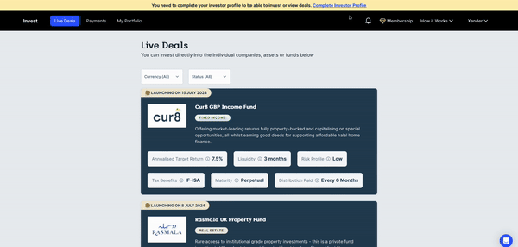
If you registered before 5th March 2024, you are now eligible to self-certify

Slide 5
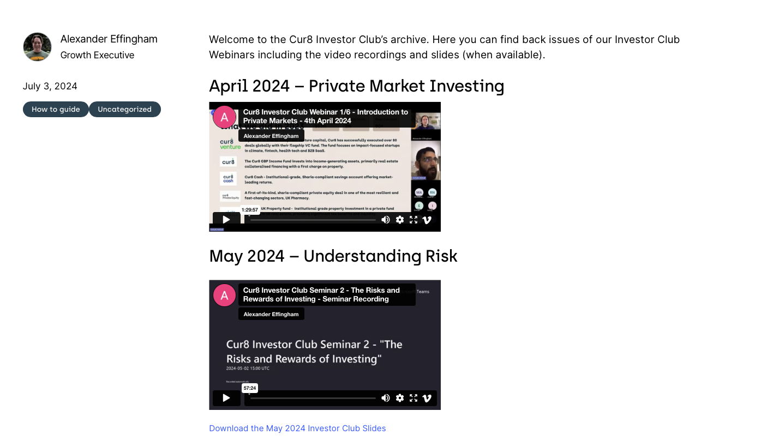
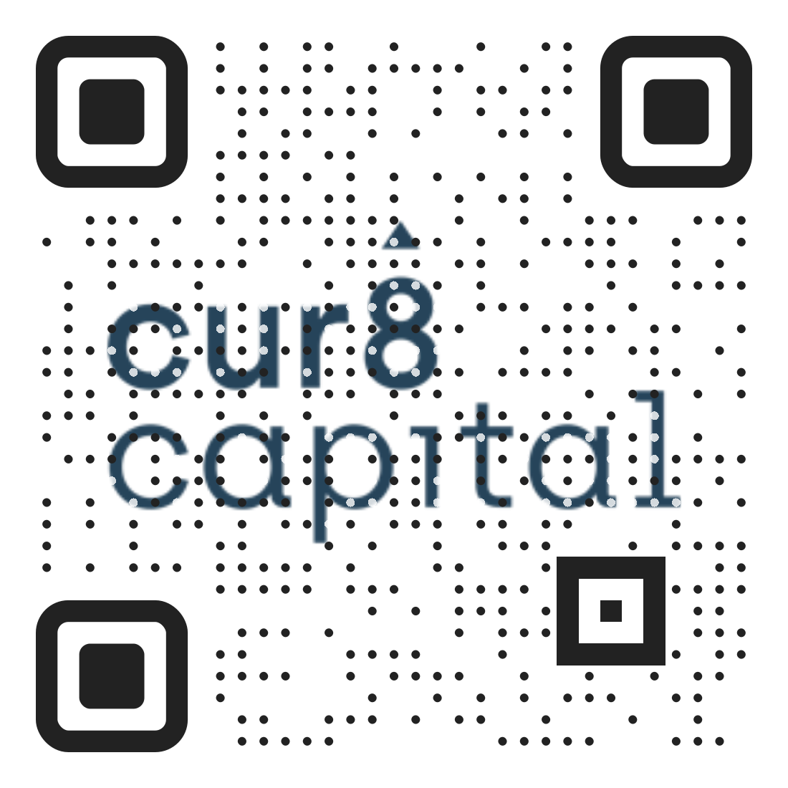
You can find previous seminars on the Cur8 website in the Investor Club Archive
Click the green link above or scan this QR code below to visit the archive (or you can find it on the Cur8 Blog)

Slide 6
For questions about onboarding email contact the team through the Cur8 chat function on the website and app.
Or you can email: xander@cur8.capital

Slide 7
Over to Ibrahim

